Slide 1
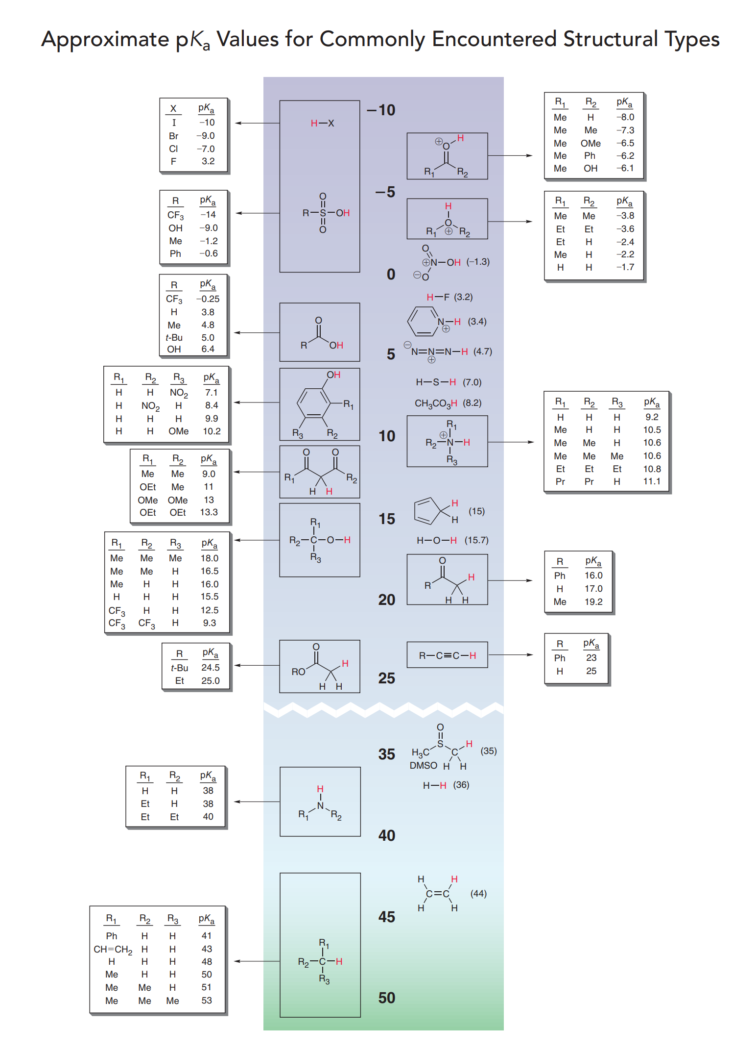
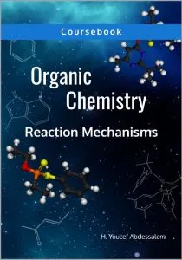
CHEM 314:
Dr. Raed Kadhim Zaidan Al-Tameemi

Slide 2
Content
Introduction (definition)
Structure of carbanion
Stability of carbanion
Formation of carbanion
Reactions of carbanion
Alpha-Hydrogen

Slide 3
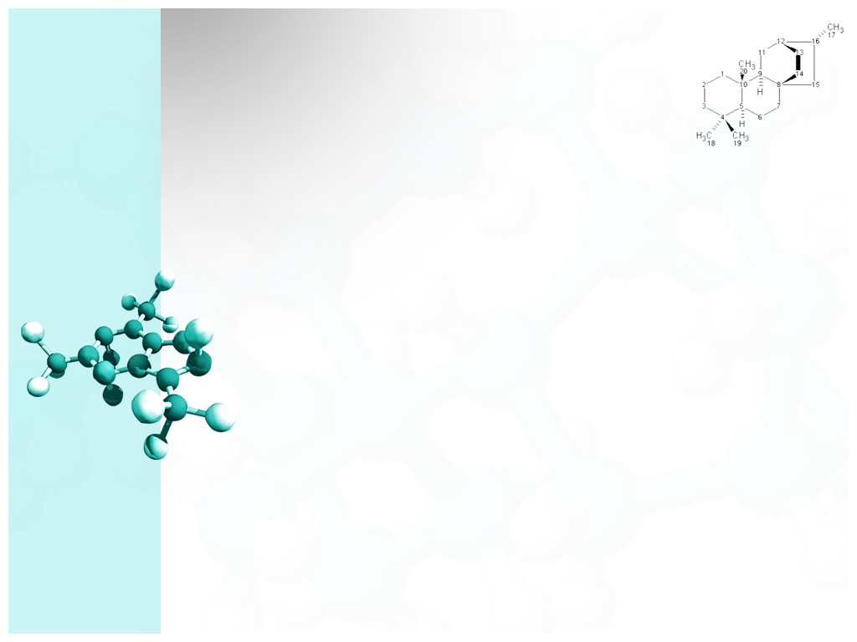
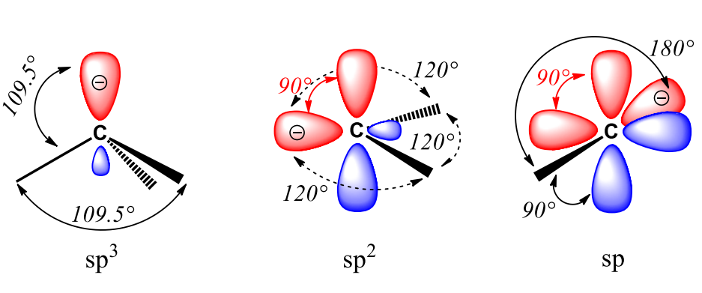
Carbanion definition
Carbanion
Definition and Structure
A carbanion is a carbon atom that has an unshared pair of electrons and bears a negative charge (-1). This particular anion can have a trigonal pyramidal geometry when it is tri-substituted carbanion (sp3 ), a bent geometry when it is bi-substituted (sp2 ), or a linear geometry in case of mono-substituted carbanions (sp).

Slide 4
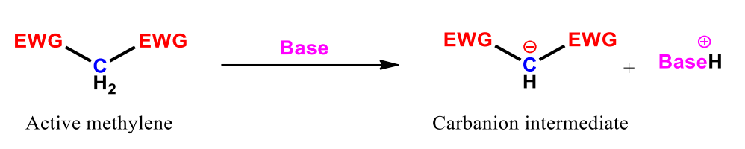
Stability of carbanion
Because carbanions are electron rich species, their stability depends upon minimizing the negative charge of the carbanion by resonance, hybridization, or inductive effect.
Resonance
Unlike carbocations, carbanions are stabilized with electron -withdrawing groups. Active methylene compounds are excellent example to demonstrate how EWGs increase the stability of carbanions.
Active methylene is a methyl group attached to two EWGs. These two EWGs pull valence electrons of the carbon atom they are attached to resulting in an acidic CH bond. When an active methylene compound is treated with a base, one hydrogen atom would be abstracted leaving a full negative charge on the carbon atom it was attached to.

Slide 5
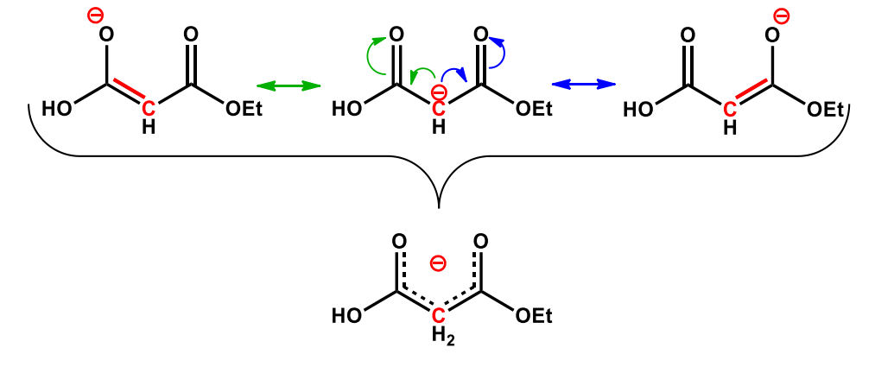
Resonance
Example
Diethyl malonate forms a stable carbanion since the negative charge can be shared between the two carbonyl function.

Slide 6
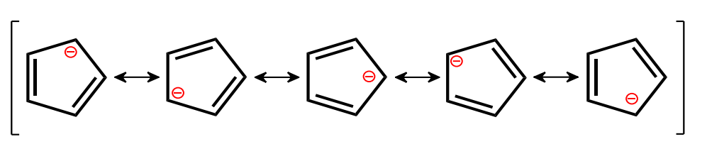
Resonance
In case of allylic and aromatic systems, the carbanion exhibits a positive mesomeric effect +M. In the example bellow, cyclopenta-2,4-dien-1-ide is stable because it is an aromatic ring where the negative charge is shared between five carbon atom.

Slide 7
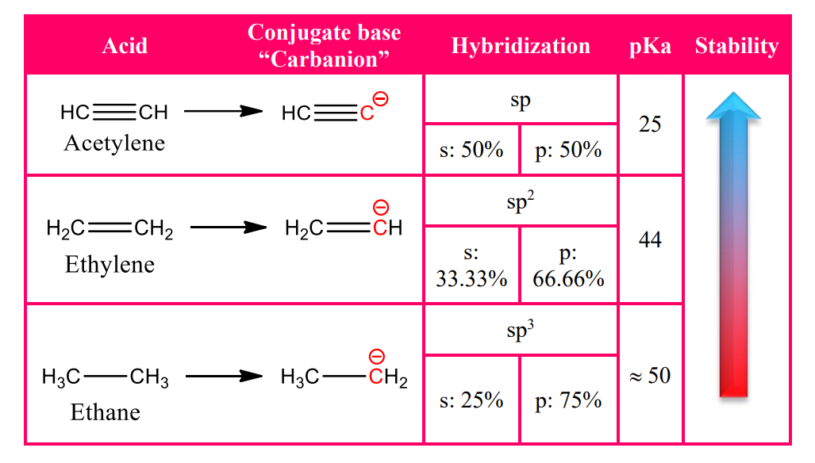
Hybridization
A carbanion species is the conjugate base form of an organic acid. As a result , the stability of a carbanion can also be measured through its acidity, which is affected by the hybridization of the carbon atom bearing the negative charge. In this case, hybridization plays a crucial role in determining whether the conjugate base is stable or not depending upon how close the negative charge is to the nucleus and therefore, acidity increases as (s) character increases. Consequently, sp hybridized carbanion is more stable than sp2 , which is more stable than sp3 .

Slide 8
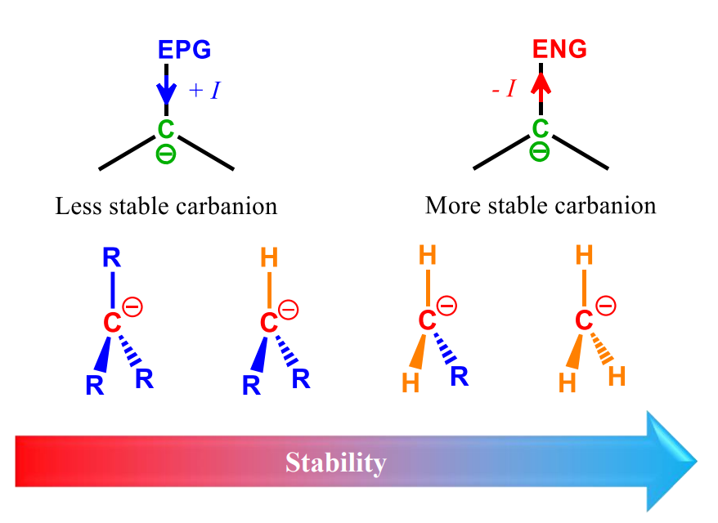
Inductive Effect
Electronegative groups stabilize carbanions through the negative inductive effect -I, which reduces the electron density of the carbanion. On the other hand, positive inductive effect +I of electropositive groups would provide more electron density to the carbanion making it less stable.

Slide 9
Types and formation of carbanion
Carbanions.
The conjugate bases of weak acids; strong bases, good nucleophiles.
enolate anions
organometallic compounds
ylides
cyanide
acetylides

Slide 10
Types of Carbanion based on hybridization
Carbanions are classified based on the hybridization of the carbon atom carrying the negative charge. The three main types of carbanions are
Alkyl Carbanions
Alkenyl (Vinyl) Carbanions
Aryl Carbanions
Alkyl Carbanions: These are derived from alkanes (sp3 carbon) and are the least stable due to the electron-donating inductive effect of the alkyl groups.
Alkenyl (Vinyl) Carbanions: These are derived from alkenes (sp2 carbon) and are more stable than alkyl carbanions due to the electron-withdrawing inductive effect of the double bond.
Aryl Carbanions: These are derived from arenes (sp2 carbon) and are the most stable due to the electron-withdrawing inductive effect of the aromatic ring.

Slide 11
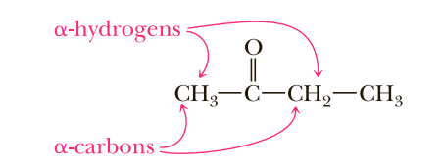
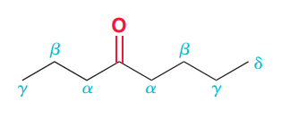
Acidity of alpha hydrogen
A carbon atom adjacent to a carbonyl group is called an α-carbon, and hydrogen atoms bonded to it are called α-hydrogens.
Because carbon and hydrogen have comparable electronegativities, a C-H bond normally has little polarity. In addition, carbon does not have a high electronegativity (compare it, for example, with oxygen, which has an electronegativity of 3.5), so that an anion based on carbon is relatively unstable. As a result, a hydrogen bonded to carbon usually shows very low acidity.

Slide 12
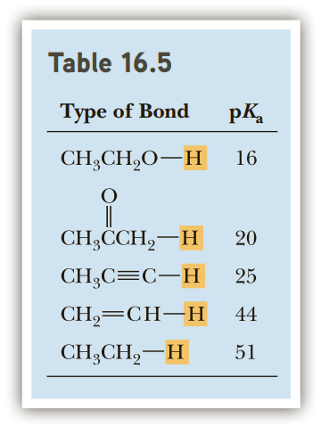
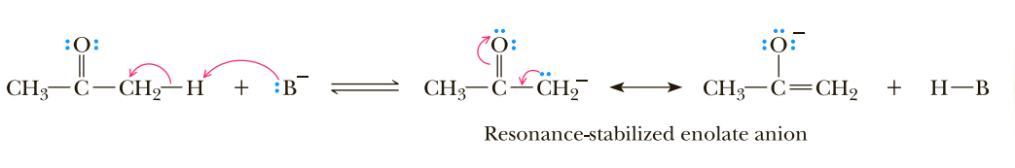
Acidity of alpha hydrogen
The situation is different, however, for hydrogens alph to a carbonyl group. α-Hydrogens are more acidic than acetylenic, vinylic, and alkane hydrogens but less acidic than -OH hydrogens of alcohols (Table 1). The greater acidity of α-hydrogens arises because the negative charge on the resulting enolate anion is delocalized by resonance, thus stabilizing it relative to an alkane, alkene, or alkyne anion.
An enolate anion is also stabilized by the electron-withdrawing inductive effect of the electronegative oxygen. Recall that we used these same factors

Slide 13
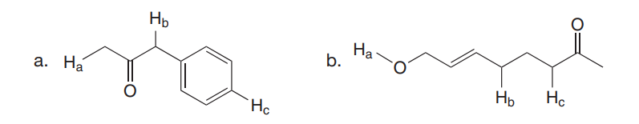
Acidity of alpha hydrogen
Problem: Rank the labeled protons in each compound in order of increasing acidity.

Slide 14
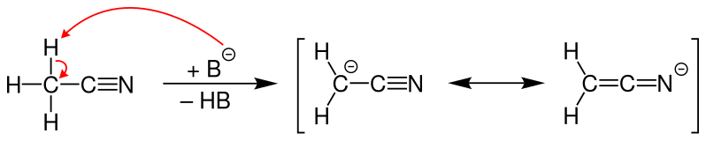
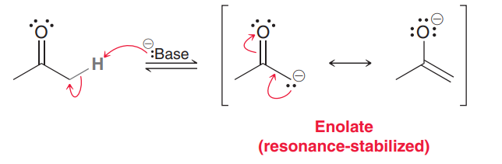
Formation of carbanion
Deprotonation of C-H bond
When proton is abstracted from a carbon center then the resulting anion is called as carbanion
The acidic hydrogen of an organic substrate can be abstracted by an appropriate base for example carbanions generated from carbonyl compound.

Slide 15
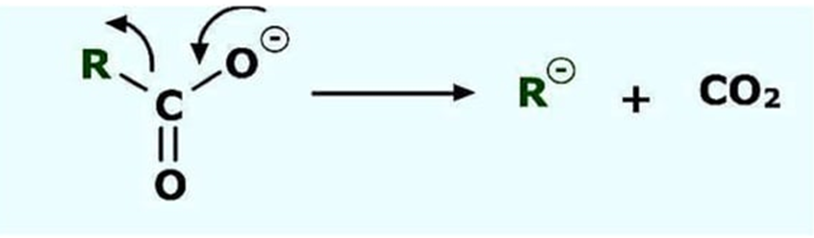
Formation of carbanion
Decarboxylation
Decarboxylation of carboxylate leads to formation of carbanions intermediate.

Slide 16
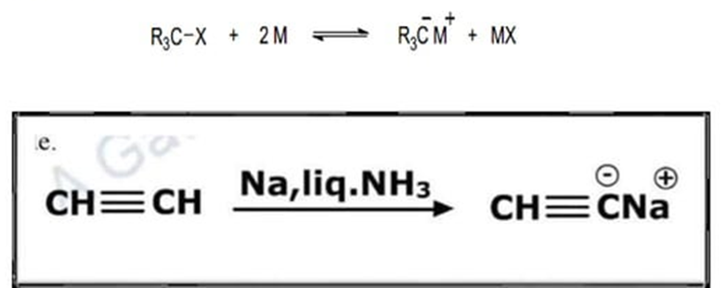
Formation of carbanion
Reduction of C-X bond with Metal
Metals which are less electro negative than carbon such as Mg, Na, Hg, etc. react with alkyl halide at appropriate condition to form the carbon metallic bond
Where carbon contain negative charge and the metal contain positive charge

Slide 17
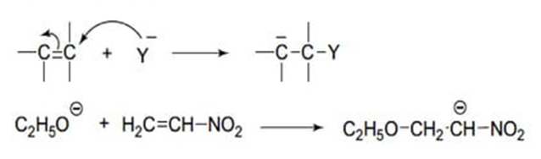
A negative ion adds to Carbon-Carbon double or triple bond
The addition of a negative ion to a carbon-carbon or triple bonds leads to a carbanion.
The addition of a negative ion to carbon-oxygen double bond does not give a carbanion, since the negative charge resides on the oxygen.
Carbanions are also formed when a nucleophile adds to an α, β-unsaturated compounds.

Slide 18
Reactions Involving Carbanions
Common Reactions
Some common reactions involving carbanions include:
Nucleophilic Substitution: Carbanions, being nucleophilic, can undergo nucleophilic substitution reactions, where they displace a leaving group in a substrate. This is a fundamental reaction in organic chemistry and is widely used in the synthesis of various organic compounds.
R-LG + Nu– → R-Nu + LG–
Addition Reactions: Carbanions can participate in addition reactions, such as 1,4-addition (Michael addition) to α,β-unsaturated carbonyl compounds, where the carbanion adds to the β-carbon of the carbonyl group. This reaction is important in the formation of carbon-carbon bonds.
Carbanion + Electrophilic Substrate → Product

Slide 19
Reactions Involving Carbanions
Alkylation and Acylation: Carbanions are commonly used in alkylation and acylation reactions, where they act as nucleophiles and react with alkyl or acyl halides to form new carbon-carbon bonds. For example, the alkylation of ketones using carbanions is a widely used synthetic method in organic chemistry.
Alkylation: Carbanion + Alkyl Halide → Product
Acylation: Carbanion + Acyl Halide → Product
Formation of Organometallic Reagents: Carbanions are involved in forming important organometallic reagents, such as organolithium and Grignard reagents, which are widely used in organic synthesis for forming carbon-carbon bonds.
Alkyl Halide + Lithium → Organolithium Reagent

Slide 20
Carbanion Rearrangements
Carbanion rearrangements are a type of reaction in which a carbanion undergoes a rearrangement to attain more stability. These rearrangements can occur through various mechanisms, such as radical-pair dissociation-recombination or concerted mechanisms. Some common carbanion rearrangements include:
Wittig Rearrangements: These rearrangements can proceed as or rearrangements. The Wittig rearrangement proceeds via a radical-pair dissociation-recombination mechanism, while the Wittig rearrangement is a concerted mechanism.
Brook Rearrangement: This rearrangement is more common in organic synthesis due to Amos B. Smith’s anion relay chemistry (ARC). In this mechanism, a silyl group migrates towards the alcoholate, liberating another carbanion, which can subsequently participate in another nucleophilic attack. This allows multiple anion-dependent reactions to occur.
Benzilic Acid Rearrangement: This rearrangement involves a carbanionic 1,2-shift and is important in forming new carbon-carbon bonds and introducing functional groups.

Slide 21
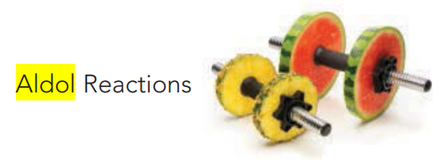
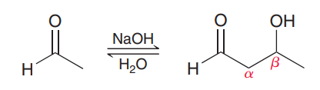
Aldol Reactions
Aldol Additions
Recall that when an aldehyde is treated with sodium hydroxide, both the aldehyde and the enolate will be present at equilibrium. Under such conditions, a reaction can occur between these two species. For example, treatment of acetaldehyde with sodium hydroxide gives 3-hydroxybutanal.
The product exhibits both an aldehydic group and a hydroxyl group, and it is therefore called an aldol (ald for “aldehyde” and ol for “alcohol”). In recognition of the type of product formed, the reaction is called an aldol addition reaction. Notice that the hydroxyl group is located specifically at the β position relative to the carbonyl group. The product of an aldol addition reaction is always a β-hydroxy aldehyde or ketone. Mechanism 1 shows three steps for an aldol addition reaction.

Slide 22
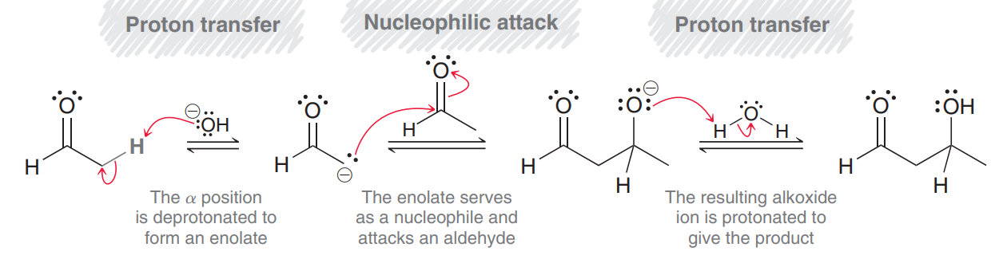
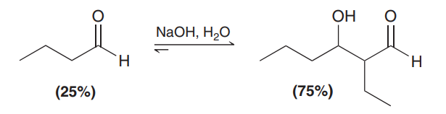


Mechanism Aldol Additions
In the first step, the aldehyde is deprotonated to form an enolate. Since hydroxide is used as the base, both the enolate and the aldehyde are present at equilibrium, and the enolate attacks the aldehyde. The resulting alkoxide ion is then protonated to yield the product. Notice the use of equilibrium arrows for every step of the mechanism. For most simple aldehydes, the position of equilibrium favors the aldol product.

Slide 23
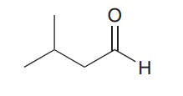
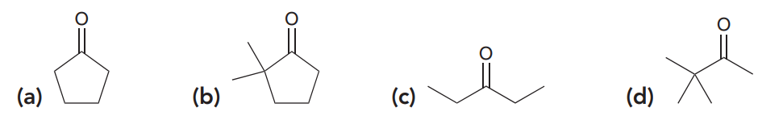
predicting the products of an aldol addition reaction
Predict the product of the aldol addition reaction that occurs when the following aldehyde is treated with aqueous sodium hydroxide.
When each of the following ketones is treated with aqueous sodium hydroxide, the aldol product is obtained in poor yields. In these cases, special distillation techniques are used to increase the yield of aldol product. In each case, predict the aldol addition product that is obtained and propose a mechanism for its formation:

Slide 24
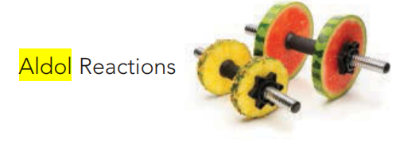
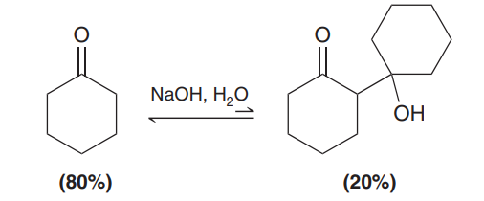


Aldol Additions
However, for most ketones, the aldol product is not favored, and poor yields are common.
In this reaction, the reverse process is favored, that is, the β-hydroxy ketone is converted back into cyclohexanone more readily than the forward reaction. This reverse process, which is called a retro-aldol reaction (Mechanism 2), can be exploited in many situations (an example can be seen in the upcoming Practically Speaking box on muscle power).

Slide 25
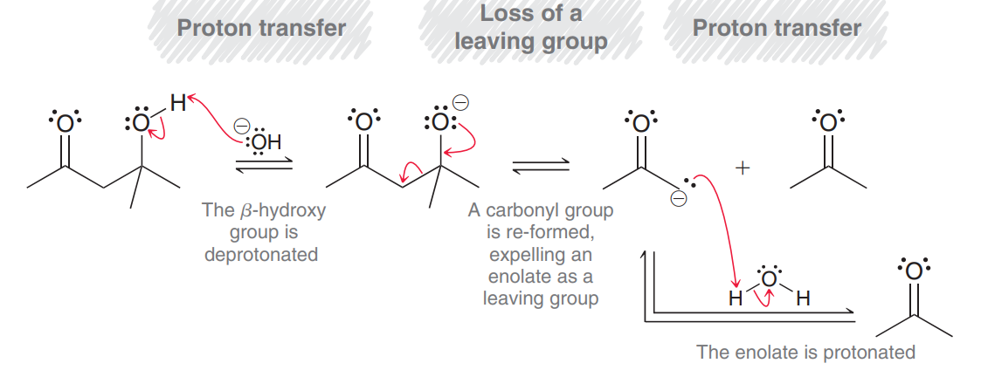
Retro-Aldol Additions
Once again, this mechanism has three steps. In fact, these three steps are simply the reverse of the three steps for an aldol addition reaction. Notice that the second step in this mechanism involves re-formation of a carbonyl group to expel an enolate ion as a leaving group. This reaction therefore represents another exception to the rule about avoiding the expulsion of C−. This exception is justified because an enolate is resonance stabilized, with the vast majority of the negative charge residing on the oxygen atom.

Slide 26
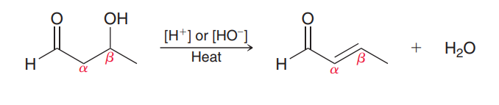
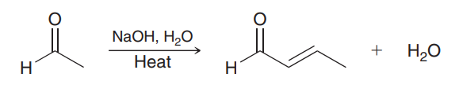




Aldol Condensations
When heated in acidic or basic conditions, the product of an aldol addition reaction will undergo elimination to produce unsaturation between the α and β positions:
Practically, this transformation is most readily achieved when an aldol addition is performed at elevated temperature. Under these basic conditions, the aldol addition reaction occurs, followed by dehydration to give an α,β-unsaturated product.

Slide 27
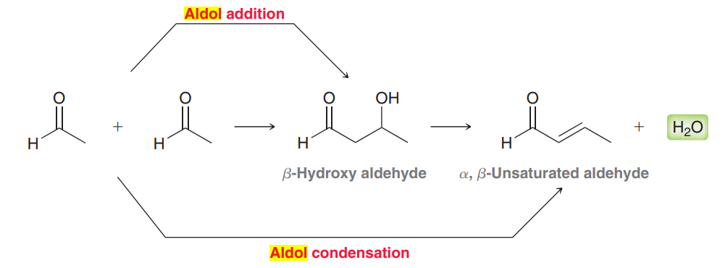

Aldol Condensations
This two-step process (aldol addition plus dehydration) is called an aldol condensation. The term condensation is used to refer to any reaction in which two molecules undergo addition accompanied by the loss of a small molecule such as water, carbon dioxide, or nitrogen gas. In the case of aldol condensations, water is the small molecule that is lost. Notice that the product of an aldol addition is a β-hydroxy aldehyde or ketone, while the product of an aldol condensation is an α,β-unsaturated aldehyde or ketone.

Slide 28
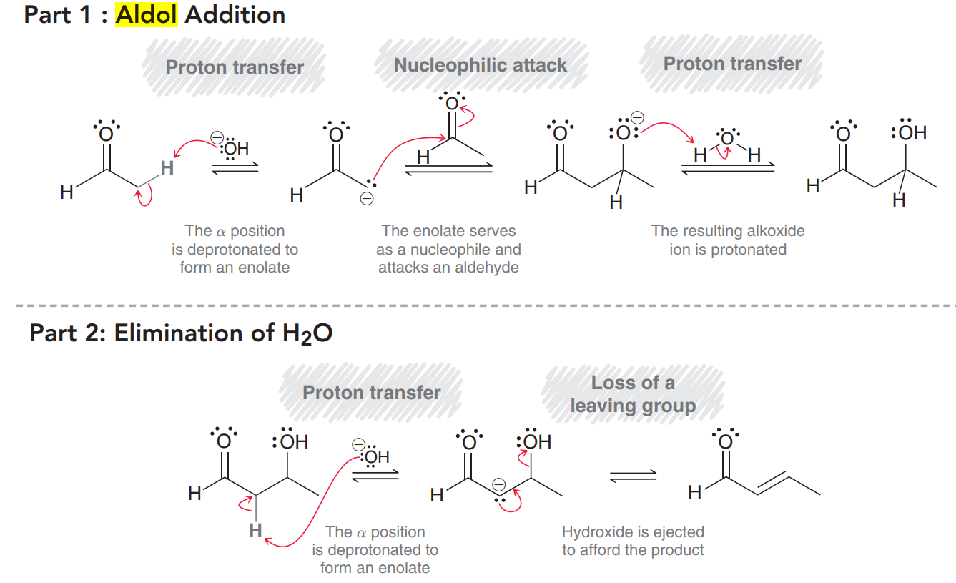
Mechanism (1) Aldol Condensation

Slide 29
Mechanism (1) Aldol Condensation
An aldol condensation (Mechanism 1) has two parts. The first part is just an aldol addition reaction, which has three mechanistic steps. The second part has two steps that accomplish the elimination of water. Normally, alcohols do not undergo dehydration in the presence of a strong base, but here, the presence of the carbonyl group renders the α position mildly acidic, thereby enabling the dehydration reaction to occur. The α position is first deprotonated to form an enolate ion, followed by expulsion of a hydroxide ion to produce α,β unsaturation. This two-step process, which is different from the elimination reactions, is called an E1cb mechanism. Unlike an E1 process, in which the intermediate is a cation, the intermediate in this case is an anion (an enolate).

Slide 30
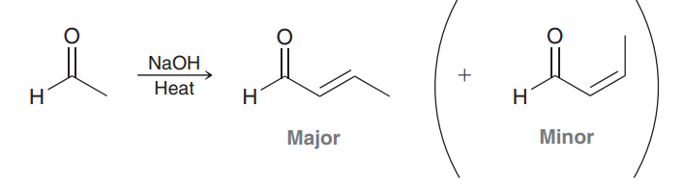
Mechanism (1) Aldol Condensation
This enolate is formed via deprotonation, so it is a conjugate base (thus the letters “cb”), and the “1” indicates that the reaction is first order. In cases where two stereoisomeric π bonds can be formed, the product with fewer steric interactions is generally the major product.
In this example, formation of the trans π bond is favored over formation of the cis π bond.

Slide 31
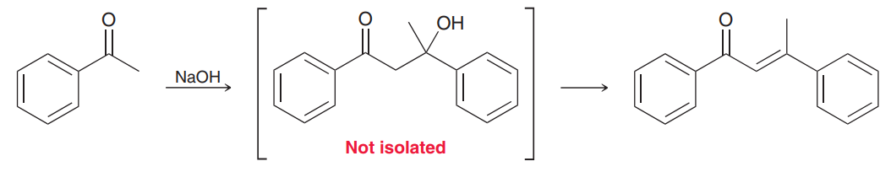
Mechanism (1) Aldol Condensation
The driving force for an aldol condensation is formation of a conjugated system. The reaction conditions required for an aldol condensation are only slightly more vigorous than the conditions required for an aldol addition reaction. Usually, an aldol condensation can be achieved by simply performing the reaction at an elevated temperature. In fact, in some cases, it is not even possible to isolate the β-hydroxyketone. As an example, consider the following case:
In this case, the aldol addition product cannot be isolated. Even at moderate temperatures, only the condensation product is obtained, because the condensation reaction involves formation of a highly conjugated π system.

Slide 32
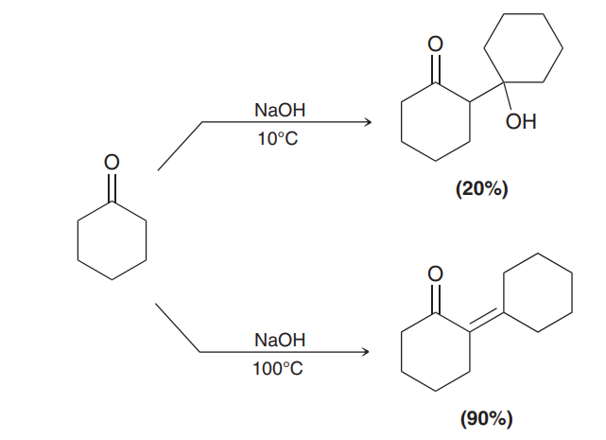
Mechanism (1) Aldol Condensation
Even in cases where the aldol addition product can be isolated (by performing the reaction at a low temperature), the yields for condensation reactions are often much greater than the yields for addition reactions. The following example illustrates this point:
When the reaction is performed at low temperature, the aldol addition product is obtained, but the yield is very poor. As explained earlier, the starting material is a ketone, and the equilibrium does not favor formation of the aldol addition product. However, when the reaction is performed at an elevated temperature, the aldol condensation product is obtained in very good yield, because the equilibrium is driven by formation of a conjugated π system.

Slide 33
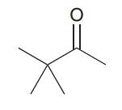
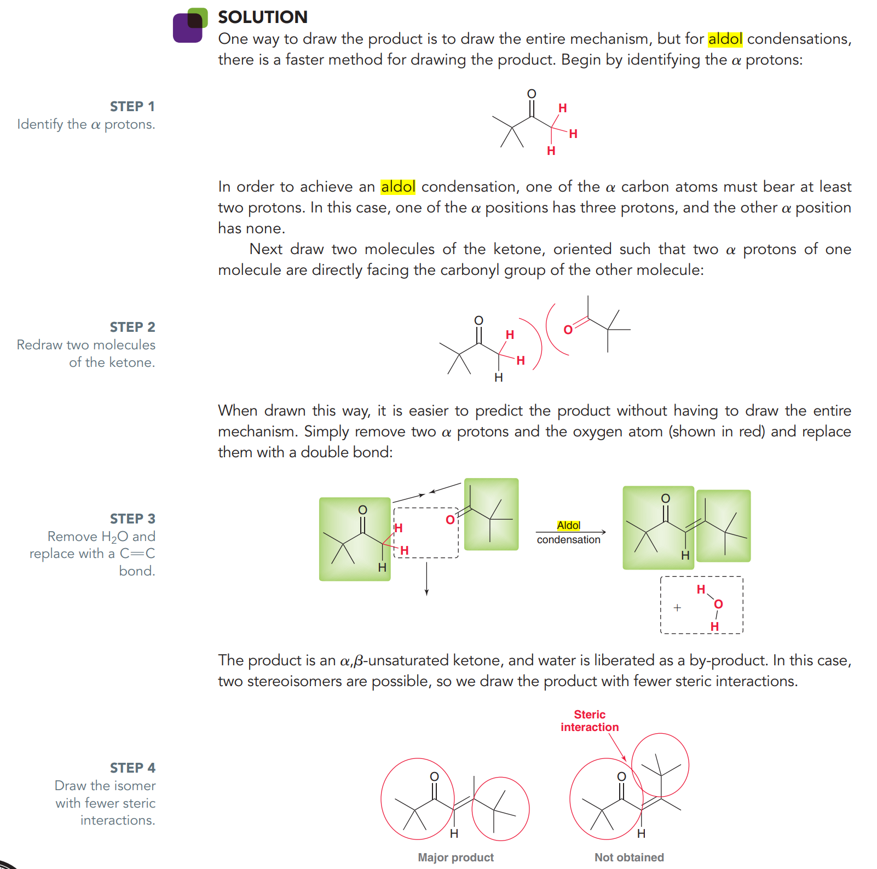
An example of Aldol Addition
Predict the product of the aldol condensation that occurs when the following ketone is heated in the presence of aqueous sodium hydroxide:

Slide 34
Crossed Aldol Reactions
Until now, we have focused on symmetrical aldol reactions, that is, aldol reactions that occur between two identical partners. In this section, we explore crossed aldol, or mixed aldol, reactions, which are aldol reactions that can occur between different partners. As an example, consider what happens when a mixture of acetaldehyde and propionaldehyde is treated with a base. Under these circumstances, four possible aldol products can be formed (Figure in the next slide).

Slide 35
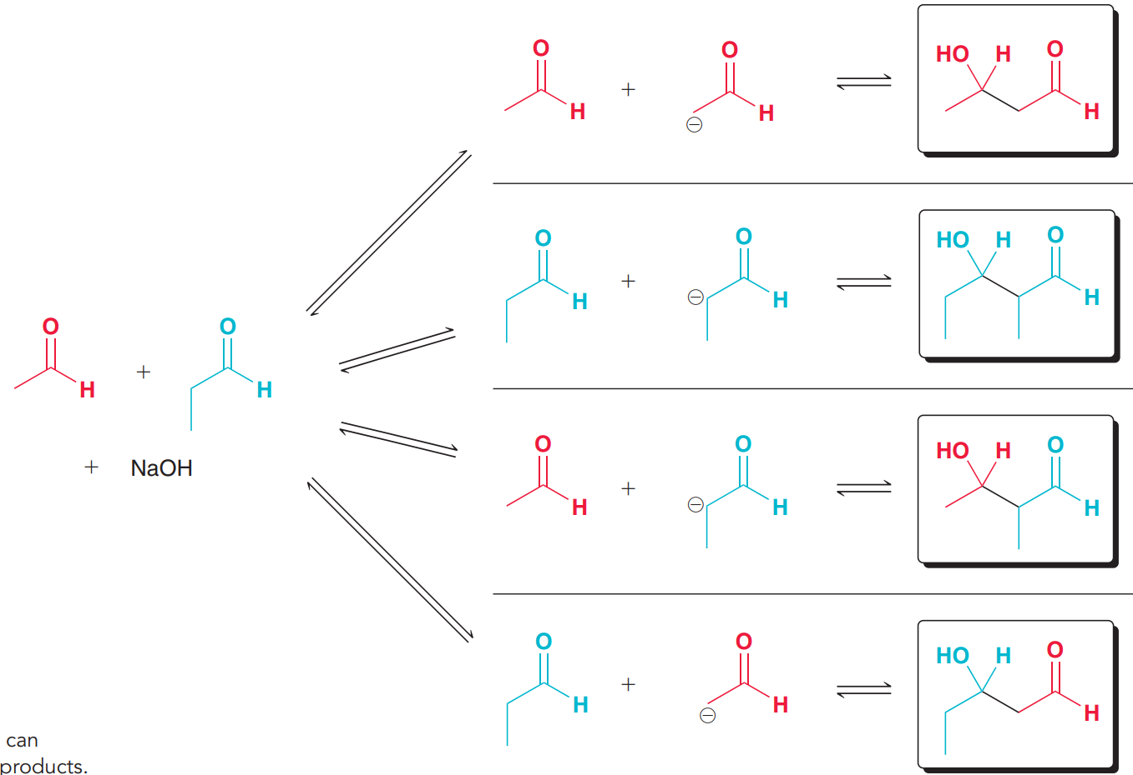




Crossed Aldol Reactions

Slide 36
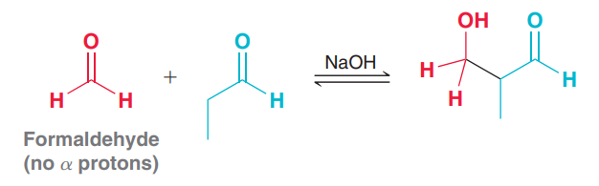
Crossed Aldol Reactions
The first two products are formed from symmetrical aldol reactions, while the latter two products are formed from crossed aldol reactions. Reactions that form mixtures of products are of little use, and therefore, crossed aldol reactions are only efficient if they can be performed in a way that minimizes the number of possible products. This is best accomplished in either of the following ways:
1. If one of the aldehydes lacks α protons and possesses an unhindered carbonyl group, then a crossed aldol can be performed. As an example, consider what happens when a mixture of formaldehyde and propionaldehyde is treated with a bas:

Slide 37
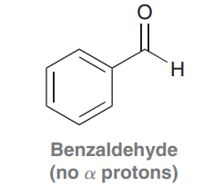
Crossed Aldol Reactions
In this case, only one major aldol product is produced. Why? Formaldehyde has no α protons and therefore cannot form an enolate. As a result, only the enolate formed from propionaldehyde is present in solution. Under these conditions, there are only two possible products. The enolate can attack a molecule of propionaldehyde to produce a symmetrical aldol reaction, or the enolate can attack a molecule of formaldehyde to produce a crossed aldol reaction. The latter occurs more rapidly because the carbonyl group of formaldehyde is less hindered and more reactive than the carbonyl group of propionaldehyde. As a result, one product predominates. Crossed aldol reactions can also be performed with benzaldehyde.

Slide 38
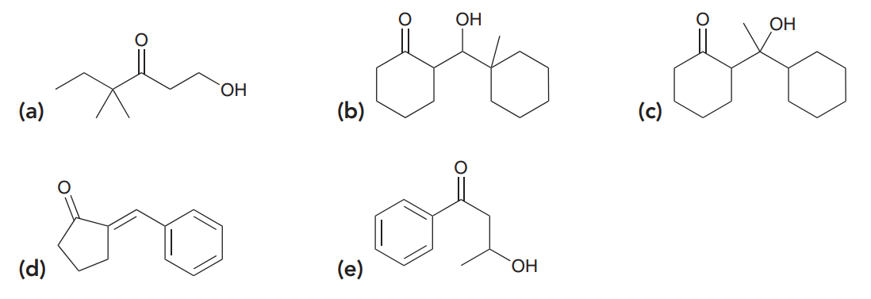
Problems
Identify reagents that can be used to produce each of the following compounds via an aldol reaction.

Slide 39
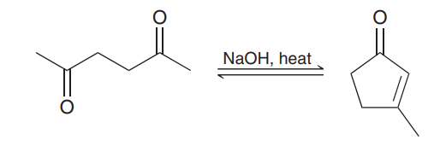
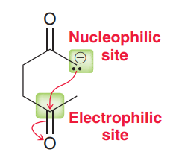
Intramolecular Aldol Reactions
Compounds that possess two carbonyl groups can undergo intramolecular aldol reactions. Consider the reaction that occurs when 2,5-hexanedione is heated in the presence of aqueous sodium hydroxide.
In this case, a cyclic product is formed. The accepted mechanism for this process is nearly identical to the mechanism for any other aldol condensation but with one notable difference—the enolate and the carbonyl group are both present in the same structure, resulting in an intramolecular attack.

Slide 40
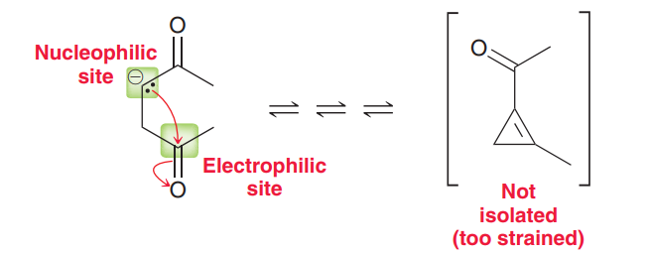
Intramolecular Aldol Reactions
Intramolecular aldol reactions show a preference for formation of five- and six-membered rings. Smaller rings are possible but are generally not observed.
It is conceivable that the three-membered ring might be formed initially, but recall that the products of aldol reactions are determined by equilibrium concentrations. Once the equilibrium has been achieved, the strained, three-membered ring is not present in substantial amounts because the equilibrium favors formation of a nearly strain-free product.

Slide 41
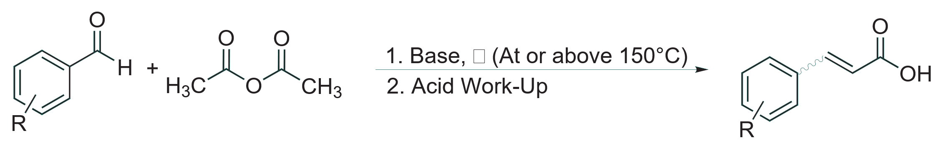
Perkin Reaction
Generating α,β-unsaturated carboxylic acids (cinnamic acid derivatives) in the presence of a weak base from aromatic aldehydes with the anhydrides of aliphatic carboxylic acids is known as the Perkin reaction. An enolate intermediate is made from the anhydride, which undergoes a condensation reaction with benzaldehyde, followed by an intramolecular acyl substitution. Further reaction with the anhydride, the base, and water affords a newly formed, typically (E) double bond.
Reagents: Weak Base (NaOAc, KOAc, CsOAc, Et₃N, etc.)
Reactant: Aromatic Aldehyde, Anhydride of Aliphatic Carboxylic Acid (with at least two α-hydrogens)
Product: α,β-Unsaturated Carboxylic Acid
Type of Reaction: Mixed Carbonyl Condensation
Bond Formation: C=C-CO₂H

Slide 42
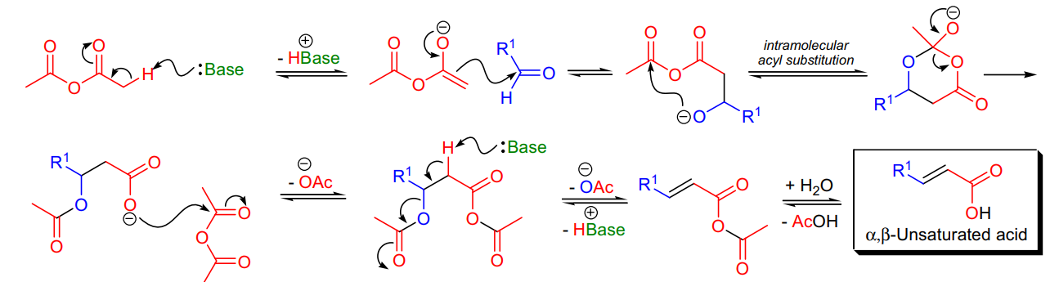
Perkin Reaction Mechanism
What is Perkin Reaction?
Perkin Reaction is an organic chemical reaction which was discovered by William Henry Perkin, an English chemist. This reaction yields an α, β -unsaturated aromatic acid.
Perkin’s reaction mechanism includes the reaction between aromatic aldehydes, the aliphatic acid anhydride, and the alkali salt of the acid to give cinnamic acid derivatives. The Perkin reaction is an organic chemical reaction named after its discoverer – William Henry Perkin.

Slide 43
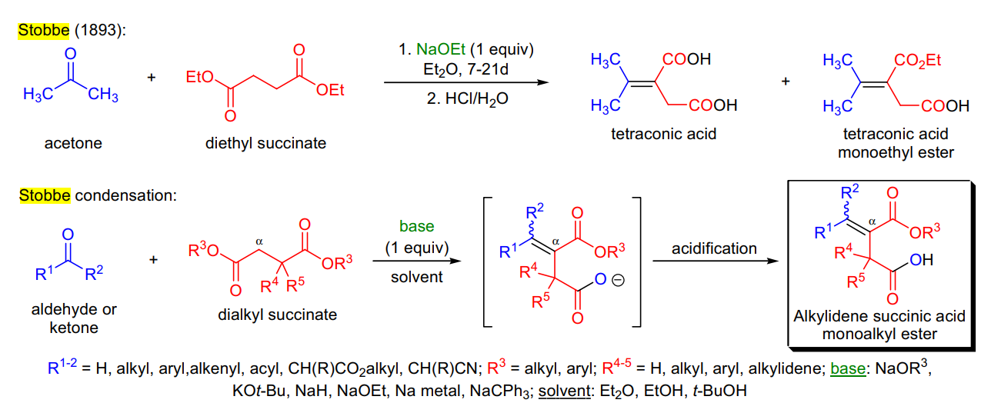
Stobbe Reaction
The Stobbe Reaction is the process of condensation in which an aldehyde or ketone is condensed with a succinic ester in the presence of potassium or sodium ethoxide to form unsaturated ester acid.

Slide 44
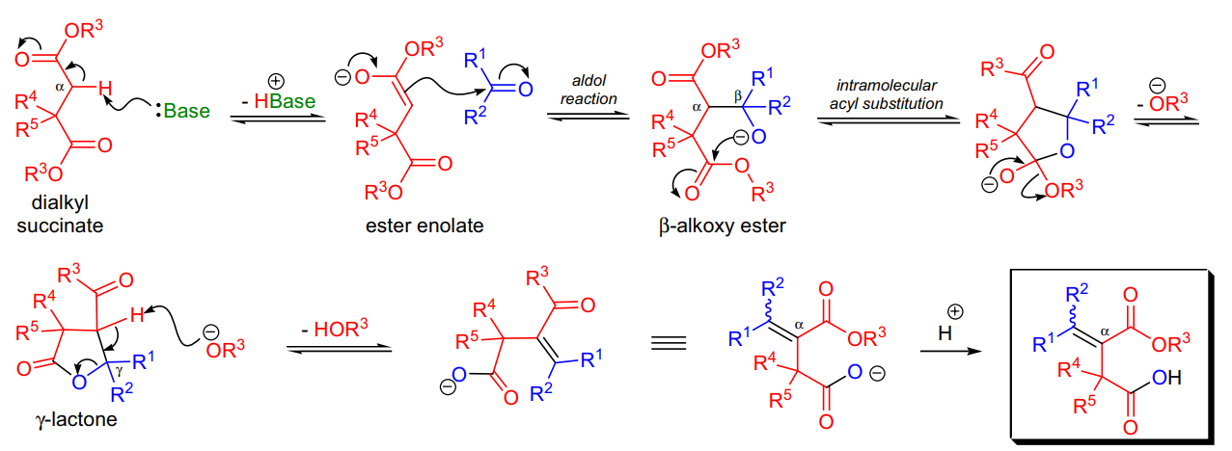
Stobbe Reaction Mechanism
The first step of the Stobbe condensation is the deprotonation of the succinate at the α-carbon to afford an ester enolate that in situ undergoes an aldol reaction with the carbonyl compound to form a β-alkoxy ester intermediate. The following intramolecular acyl substitution gives rise to a γ-lactone intermediate which undergoes ring-opening and concomittant double bond formation upon deprotonation by the alkoxide ion. Under certain conditions the lactone intermediate can be isolated.

Slide 45
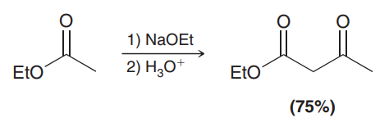
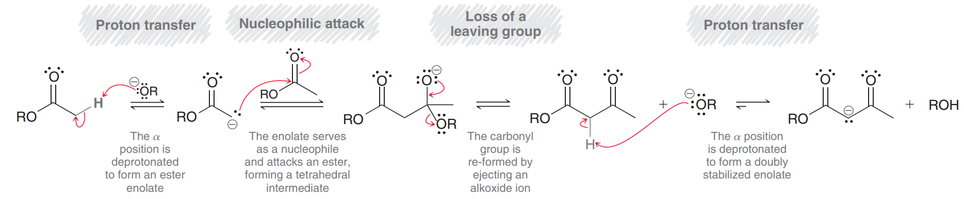
Claisen Condensations
The Claisen Condensation
Like aldehydes and ketones, esters also exhibit reversible condensation reactions.
This type of reaction is called a Claisen condensation, and a mechanism for this process is shown in Mechanism below.

Slide 46


Slide 47

Crossed Claisen Condensations
Claisen condensation reactions that occur between two different partners are called crossed Claisen condensations. Just as we saw with aldol reactions, crossed Claisen condensation reactions also produce a mixture of products and are only efficient if one of the two following criteria are met:
If one ester has no α protons and cannot form an enolate; for example:
In this reaction, the aryl ester lacks α protons and cannot form an enolate. Only the other ester is capable of forming an enolate, which reduces the number of possible products.

Slide 48

Crossed Claisen Condensations
2. A directed Claisen condensation can be performed in which LDA is used as a base to irreversibly form an ester enolate, which is then treated with a different ester.

Slide 49


Intramolecular Claisen Condensations: The Dieckmann Cyclization
Just as we saw with aldol reactions, Claisen condensations can also occur in an intramolecular fashion; for example:
This process is called a Dieckmann cyclization, and the product is a cyclic, β-keto ester. Notice that the ester enolate and the ester group are both present in the same molecule, resulting in an intramolecular attack.
Intramolecular Claisen condensations show a preference for formation of five- and six-membered rings, just as we saw with intramolecular aldol reactions.

Slide 50



Reformatsky Reaction
In 1887, S. Reformatsky, reported that in the presence of zinc metal, iodoacetic acid ethyl ester reacted with acetone to yield 3-hydroxy-3-methylbutyric acid ethyl ester. Since this initial report, the classical Reformatsky reaction was defined as the zinc-induced reaction between an α-halo ester and an aldehyde or ketone. The scope of the reaction, however, extends far beyond this original definition, and today, the metal-induced reaction of α-carbonyl halides with a wide range of electrophiles are referred to as the Reformatsky reaction. The reaction is a two stage process: first the activated zinc metal inserts into the carbon-halogen bond, and this is followed by the reaction of the zinc enolate (Reformatsky reagent) with the carbonyl compound in an aldol reaction.

Slide 51



Reformatsky Reaction mechanism
Spectroscopic and crystallographic studies of Reformatsky reagents derived from α-halo esters showed that the enolate is present in the C-enolate form and in ether solvents they form dimers. Enolates derived from α-halo ketones prefer the O-metal enolate form. It is assumed, based on theoretical calculation, that the zinc enolate dimers are dissociated by the action of the carbonyl compound and converted to the corresponding O-zinc enolates. Subsequently, the reaction goes through six-membered chairlike transition state.

Slide 52
Benzoin and Retro-Benzoin condensation
Upon treating certain (but not all) aromatic aldehydes or glyoxals (α-keto aldehydes) with cyanide ion (CN⁻ ), benzoins (α-hydroxy-ketones or acyloins) are produced in a reaction called the benzoin condensation. The reverse process is called the retro-benzoin condensation, and it is frequently used for the preparation of ketones. The condensation involves the addition of one molecule of aldehyde to the C=O group of another. One of the aldehydes serves as the donor and the other serves as the acceptor. Some aldehydes can only be donors (e.g. p-dimethylaminobenzaldehyde) or acceptors, so they are not able to self-condense, while other aldehydes (benzaldehyde) can perform both functions and are capable of self-condensation.

Slide 53

Benzoin and Retro-Benzoin condensation
Certain thiazolium salts can also catalyze the reaction in the presence of a mild base. This version of the benzoin condensation is more synthetically useful than the original procedure because it works with enolizable and non-enolizable aldehydes and asymmetric catalysts may be used. Aliphatic aldehydes can also be used and mixtures of aliphatic and aromatic aldehydes give mixed benzoins. Recently, it was also shown that thiazolium-ion based organic ionic liquids (OILs) promote the benzoin condensation in the presence of small amounts of triethylamine. The stereoselective synthesis of benzoins has been achieved using chiral thiazolium salts as catalysts.

Slide 54

Benzoin condensation mechanism
All the steps of the cyanide ion catalyzed benzoin condensation are completely reversible, and the widely accepted mechanism involves the loss of the aldehydic proton in the key step. This deprotonation is possible due to the increased acidity of this C-H bond caused by the electron-withdrawing effect of the CN group. The cyanide ion is a very specific catalyst of the reaction. Cyanide is a good nucleophile, a good leaving group, and its electron-withdrawing effect enhances the acidity of the aldehyde hydrogen.

Slide 55

Benzoin condensation mechanism
The generally accepted mechanism of the thiazolium salt-catalyzed benzoin condensation was first proposed by R. Breslow.

Slide 56
Benzilic acid rearrangement
Upon treatment with base (e.g., NaOH), α-diketones rearrange to give salts of α-hydroxy acids. This process is called the benzilic acid rearrangement. The reaction takes place with both aliphatic and aromatic α-diketones and α-keto aldehydes. Usually diaryl diketones undergo benzilic acid rearrangements in excellent yields, but aliphatic αdiketones that have enolizable α-protons give low yields due to competing aldol condensation reactions. Cyclic αdiketones undergo the synthetically useful ring-contraction benzilic acid rearrangement reaction under these conditions. When alkoxides or amide anions are used in place of hydroxides, the corresponding esters and amides are formed. This process is called the benzilic ester rearrangement.

Slide 57

Benzilic acid rearrangement
Alkoxides that are readily oxidized such as ethoxide (EtO⁻) or isopropoxide (Me₂CHO⁻) are not synthetically useful, since these species reduce the α-diketones to the corresponding α-hydroxy ketones. Aryl groups tend to migrate more rapidly than alkyl groups. When two different aryl groups are available, the major product usually results from migration of the aromatic ring with the more powerful electron-withdrawing group(s).

Slide 58

Benzilic acid rearrangement mechanism
The benzilic acid rearrangement is an irreversible process. The first step of the mechanism is the addition of the nucleophile (HO⁻ , alkoxide, or amide ion) across the C=O bond to give a tetrahedral intermediate. The next step is aryl or alkyl migration to form the corresponding α-hydroxy acid salt.

Slide 59

The Mannich Reaction
Compounds capable of forming an enol react with imines from formaldehyde and a primary or secondary amine to yield β-aminoalkyl carbonyl compounds called Mannich bases. The following reaction of acetone, formaldehyde, and diethylamine is an example:
The Mannich reaction apparently proceeds through a variety of mechanisms depend ing on the reactants and the conditions that are employed. The mechanism below appears to operate in neutral or acidic media. Note the aspects in common with imine formation and with reactions of enols and carbonyl groups.

Slide 60

Mechanism of Mannich reaction

Slide 61


The Acetoacetic Ester Synthesis
The acetoacetic ester synthesis is a useful technique that converts an alkyl halide into a methyl ketone with the introduction of three new carbon atoms.
This process is very similar to the malonic ester synthesis except that the key reagent is ethyl acetoacetate rather than diethyl malonate.
Ethyl acetoacetate is very similar in structure to diethyl malonate, but one of the ester groups has been replaced with a ketone group.

Slide 62



The Acetoacetic Ester Synthesis
The first step of the acetoacetic ester synthesis is analogous to the first step of the malonic ester synthesis. Ethyl acetoacetate is first deprotonated, forming a doubly stabilized enolate.
This enolate is then treated with an alkyl halide (RX), resulting in an alkylation step.
Treatment with aqueous acid then results in hydrolysis of the ester group.

Slide 63


The Acetoacetic Ester Synthesis
If hydrolysis is performed at an elevated temperature, the resulting β-keto acid will undergo decarboxylation to produce a ketone and carbon dioxide.
This process is very similar to the process we discussed for 1,3-dicarboxylic acids. A pericyclic reaction forms an enol, which then undergoes tautomerization to form a ketone. Decarboxylation can occur because the carboxylic acid exhibits a carbonyl group in the β position, which enables the pericyclic reaction shown above. Below is an example of an acetoacetic ester synthesis.

Slide 64

The Acetoacetic Ester Synthesis
Notice the similarity to the malonic ester synthesis. Ethyl acetoacetate is the starting material. It is first deprotonated, then treated with an alkyl halide, and then treated with aqueous acid at elevated temperature. Ethyl acetoacetate can also be dialkylated, followed by treatment with aqueous acid, to produce ketones as follows:
In this reaction sequence, ethyl acetoacetate is alkylated twice, each time with a different alkyl group. Then, hydrolysis followed by decarboxylation produces a derivative of acetone in which two alkyl groups are positioned at the α position. Why is it necessary to use an acetoacetic ester synthesis instead of simply treating the enolate of acetone with an alkyl halide? Wouldn’t that be a more direct method for preparing substituted acetones? There are two answers to this question: (1) Direct alkylation of enolates is often difficult to achieve in good yields and (2) enolates are not only strong nucleophiles, but they are also strong bases, and as a result, enolates can react with alkyl halides to produce elimination products.

Slide 65




Slide 66



Conjugate Addition Reactions
Michael Reactions
Recall that the product of an aldol condensation is an α,β-unsaturated aldehyde or ketone; for example
Aldehydes and ketones that possess α,β unsaturation, like the compound above, exhibit unique reactivity at the β position. In this section, we will explore reactions that can take place at the β position. To understand why the β position is reactive, we must draw resonance structures.

Slide 67


Michael Reactions
Notice that two of the resonance contributors exhibit a positive charge. In other words, the compound will have two electrophilic positions
Both of these positions are therefore subject to attack by a nucleophile, and the nature of the nucleophile determines which position is attacked. For example, Grignard reagents tend to attack the carbonyl group rather than the β position.

Slide 68


Michael Reactions
In this reaction, the nucleophile attacks the carbonyl group, giving a tetrahedral intermediate, which is then treated with a proton source in a separate step. In this process, two groups (R and H) have added across the C=O π bond in a 1,2-addition. A different outcome is observed when a lithium dialkyl cuprate (R₂CuLi) is employed
In this case, the nucleophile is less reactive than a Grignard reagent, and the R group is ultimately positioned at the β position. A variety of nucleophiles can be used to attack the β position of an α,β-unsaturated aldehyde or ketone. The process involves attack at the β position followed by protonation to give an enol.

Slide 69

Michael Reactions
This type of reaction is called a conjugate addition, or a 1,4-addition, because the nucleophile and the proton have added across the ends of a conjugated π system. when we explored the reactivity of conjugated dienes. A major difference between conjugate addition across a diene and conjugate addition across an enone is that the latter produces an enol as the product, and the enol rapidly tautomerizes to form a carbonyl group.
After the reaction is complete, it might appear that the two groups (shown in red) have added across the α and β positions in a 1,2-addition. However, the actual mechanism likely involves a 1,4-addition followed by tautomerization to give the ultimate product shown.

Slide 70


Michael Reactions
With this in mind, let’s now explore the outcome of a reaction in which an enolate ion is used as a nucleophile to attack an α,β-unsaturated aldehyde or ketone. In general, enolates are less reactive than Grignard reagents but more reactive than lithium dialkyl cuprates. As such, both 1,2-addition and 1,4-addition are observed, and a mixture of products is obtained. In contrast, doubly stabilized enolates are sufficiently stabilized to produce 1,4-conjugate addition exclusively.
In this case, the starting diketone is deprotonated to form a doubly stabilized enolate ion, which then serves as a nucleophile in a 1,4-conjugate addition. This process is called a Michael reaction. The doubly stabilized enolate is called a Michael donor, while the α,β-unsaturated aldehyde is called a Michael acceptor.

Slide 71



Michael Reactions
A variety of Michael donors and acceptors are observed to react with each other to produce a Michael reaction. Table below shows some common examples of Michael donors and acceptors. Any one of the Michael donors in this table will react with any one of the Michael acceptors to give a 1,4-conjugate addition reaction.

Slide 72

Robinson Annulation
Robinson Annulation
Named after the British chemist Robert Robinson, Robinson annulation is a cyclization reaction to create a six membered ring by forming three carbon–carbon bonds (A Michael addition followed by a simple aldol condensation). This particular reaction is widely used in the synthesis of terpenes, and steroids.

Slide 73

Robinson Annulation mechanism
Mechanism
Robinson annulation is carried out under basic condition s and it proceeds in two stages. Initially, Michael addition takes place between a cyclic ketone and a Michael acceptor, which gives a 1,5-diketone compound.

Slide 74


Robinson Annulation mechanism
The second reaction is an intramolecular aldol condensation whereby the 1,5-diketone compound converts into an α, β-unsaturated ketone.
In terms of ste reochemistry, Robinson annulation can yield a mixture of stereoisomers since the final product may have new stereocenters.

Slide 75

Practice problem about Robinson annulation
Propose step-by-step mechanisms for both transformations of the Robinson annulation sequence just shown.
Would you expect 2-methylcyclohexane-1,3-dione to be more or less acidic than cyclohexanone? Explain your answer.

Slide 76

Wittig Reactions
Georg Wittig, a German chemist, was awarded the 1979 Nobel Prize in Chemistry for his work with phosphorus compounds and his discovery of a reaction with enormous synthetic utility. This reaction is called the Wittig reaction (pronounced Vittig):

Slide 77


Wittig Reactions mechanism of
An example of Wittig reaction

Slide 78


Bicyclic compounds
Naming Bicyclic Compounds
Bicyclic ring systems—compounds that contain two rings that share one or two carbon atoms— can be bridged, fused, or spiro

Slide 79


Naming Bicyclic Compounds
Fused and bridged ring systems are named as bicyclo[x.y.z]alkanes, where the parent alkane corresponds to the total number of carbons in both rings. The numbers x, y, and z refer to the number of carbons that join the shared carbons together, written in order of decreasing size. For a fused ring system, z always equals zero, because the two shared carbons are directly joined together. The shared carbons in a bridged ring system are called the bridgehead carbons.

Slide 80

Bicyclic Compounds with Substituents
The presence of substituents in a bicyclic compound doesn’t affect the main rule for numbering which is to start it from one of the bridgehead carbon atoms and move in the direction of the larger ring towards the other bridgehead carbon atom.
For example, despite the presence of a Br group in the left ring, the larger ring on the right gets the priority and is numbered first. The substituent is placed in the beginning of the name just like in the nomenclature of alkanes:

Slide 81

Bicyclic Compounds with Substituents

Slide 82

Bicyclic Compounds with Substituents
Now what if the rings are the same – they have the same number of carbon atoms? In this case, the one with a substituent gets the priority. For example:
Both rings (left and right) have the same number of carbons. Therefore, the priority is given based on the methyl substituent. The ring on the top has only two carbon atoms and thus it gets the lowest priority despite the presence of a substituent which ring 2 lacks.

Slide 83


Bicyclic Compounds with Substituents
The last part of this post will be a summary chart for naming bicyclic compounds which you can also use to practice some additional examples below:
Practice
1. Name each of the following bicyclic compounds:

Slide 84


Naming Bicyclic Compounds
Rings are numbered beginning at a shared carbon, and continuing around the longest bridge first, then the next longest, and so forth.
Spiro ring systems are named as spiro[x.y]alkanes, where the parent alkane corresponds to the total number of carbons in both rings, and x and y refer to the number of carbons that join the shared carbon (the spiro carbon), written in order of increasing size. When substituents are present, the rings are numbered beginning with a carbon adjacent to the spiro carbon in the smaller ring.

Slide 85


Bredt’s Rule
We have seen that a trans cycloalkene is not stable unless there are at least eight carbon atoms in the ring. An interesting extension of this principle is called Bredt’s rule.
Let’s review exactly what Bredt’s rule means. A bicyclic compound contains two rings. The bridgehead carbon atoms are part of both rings, with three links connecting them. A bridged bicyclic compound has at least one carbon atom in each of the three links between the bridgehead carbons. In the following examples, the bridgehead carbon atoms are circled in red.

Slide 86

Bredt’s Rule
If there is a double bond at the bridgehead carbon of a bridged bicyclic system, one of the two rings contains a cis double bond and the other must contain a trans double bond. For example, the following structures show that the norbornane ring system contains a five-membered ring and a six-membered ring. If there is a double bond at the bridgehead carbon atom, the five-membered ring contains a cis double bond and the six-membered ring contains a trans double bond. This unstable arrangement is called a “Bredt’s rule violation.” If the larger ring contains at least eight carbon atoms, then it can contain a trans double bond and the bridgehead double bond is stable.

Slide 87

Bredt’s Rule

